Slide 1


Unit 3: Lesson 11
How can you help?

Slide 2

Open your book on page 64.

Slide 3
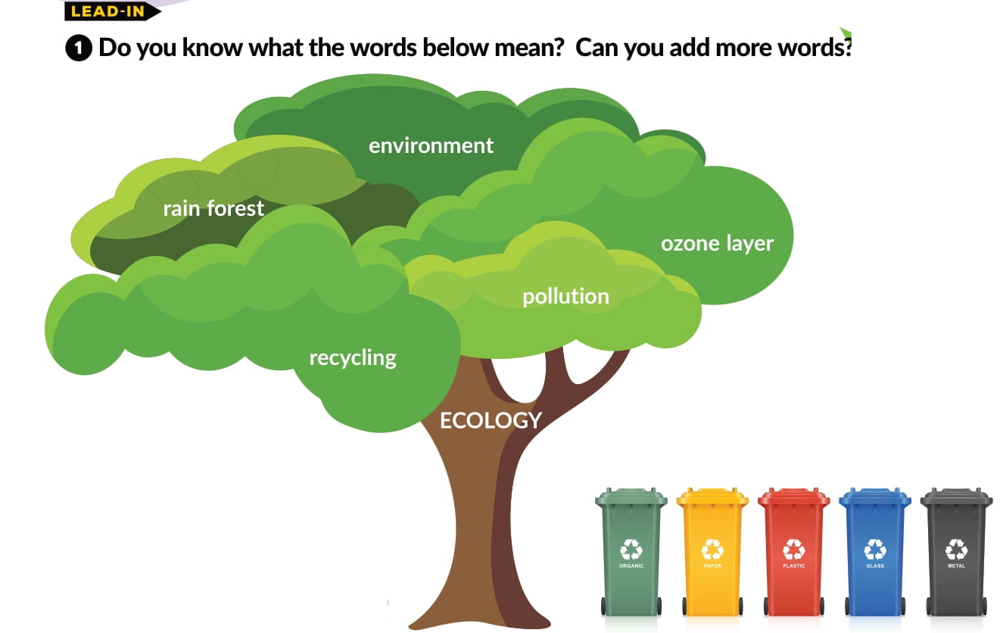

Slide 4
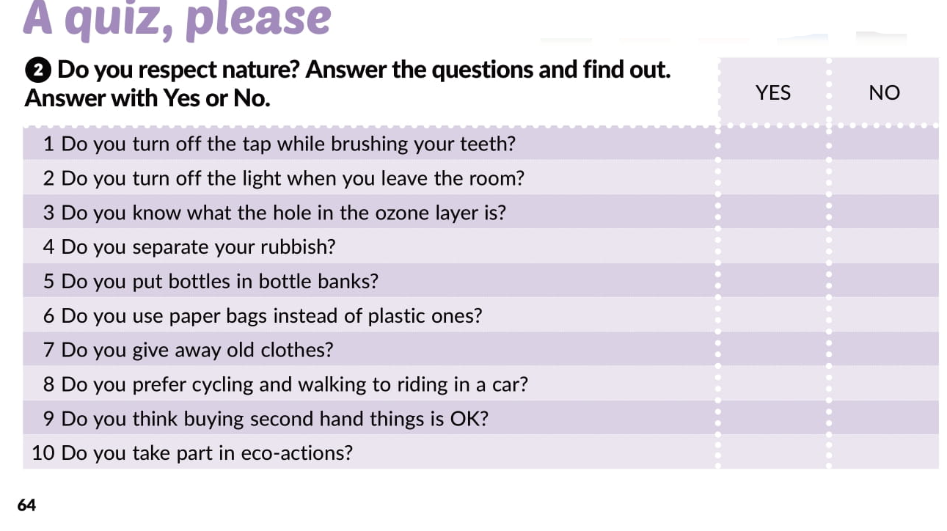

Slide 5
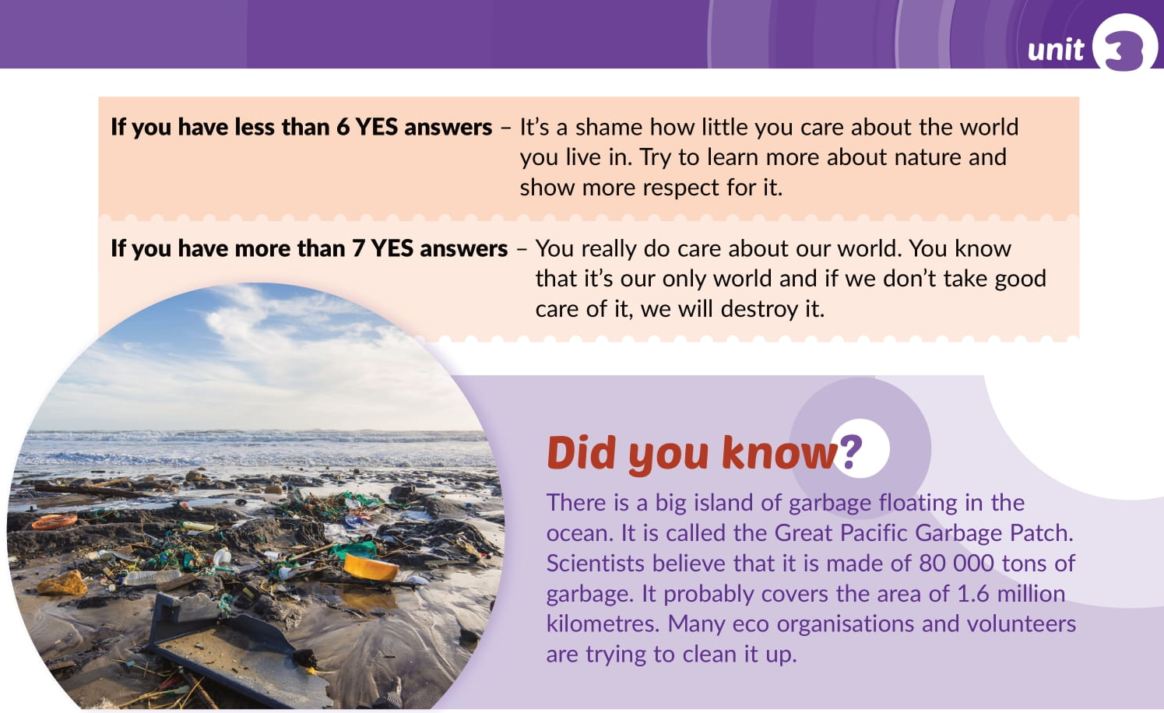

Slide 6

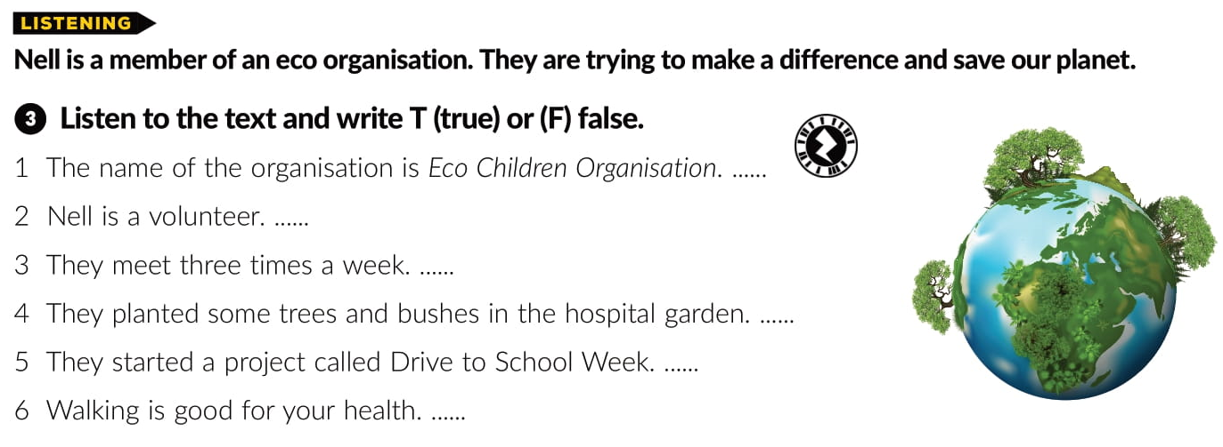
T
F
F
F
F
T

Slide 7
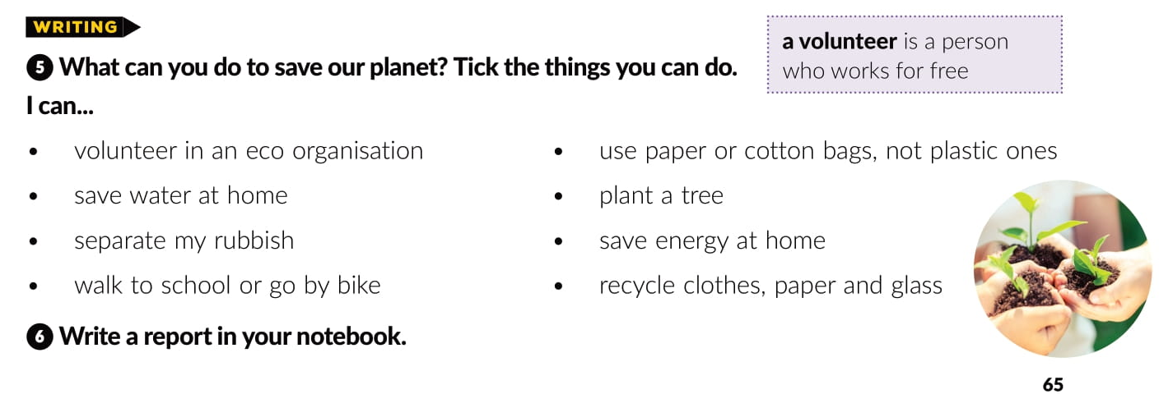

Slide 8
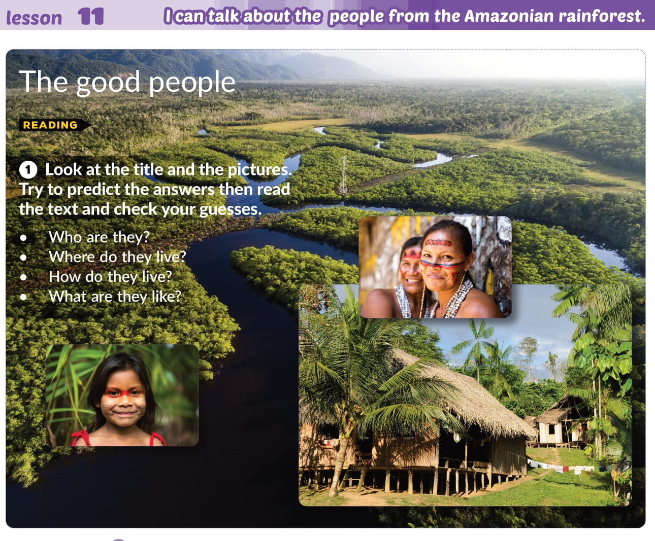

Slide 9
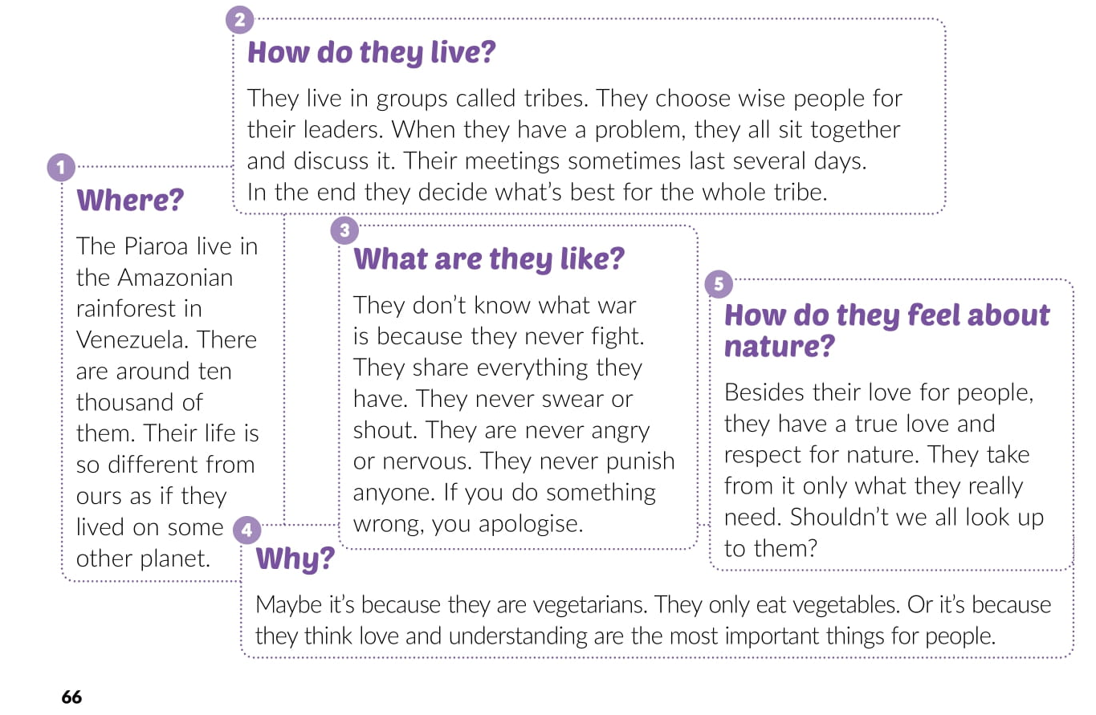

Slide 10
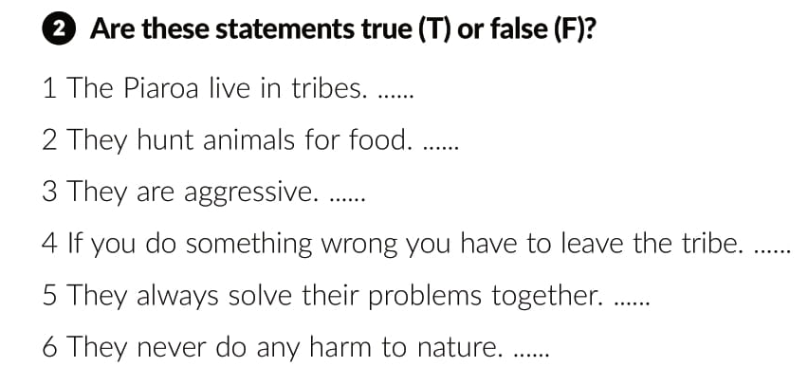
T
F
F
F
T
T

Slide 11
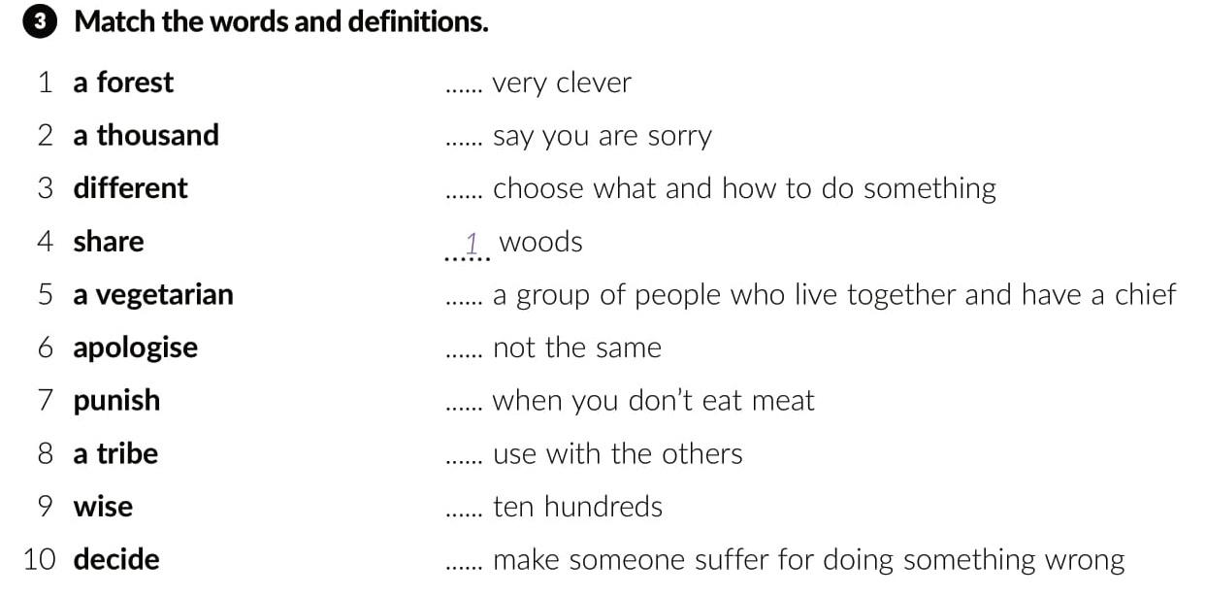
9
6
10
8
3
5
4
2
7

Slide 12
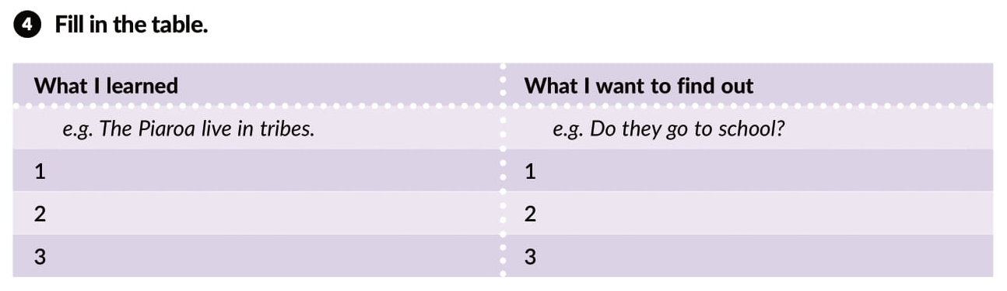
They don’t eat meat.
They always solve problems together.
They choose wise people to be leaders.

Slide 13
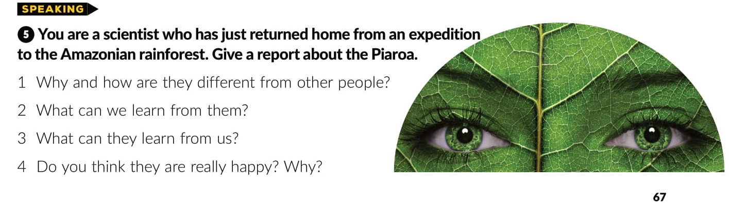

Slide 14
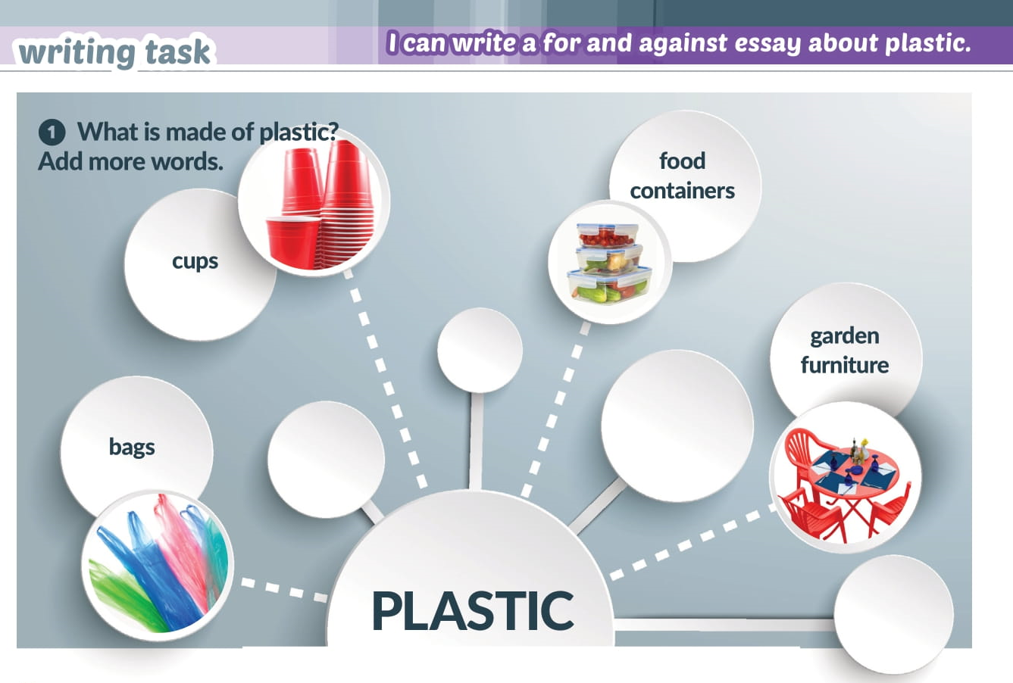
toys
toothbrushes
bottles
clothes

Slide 15
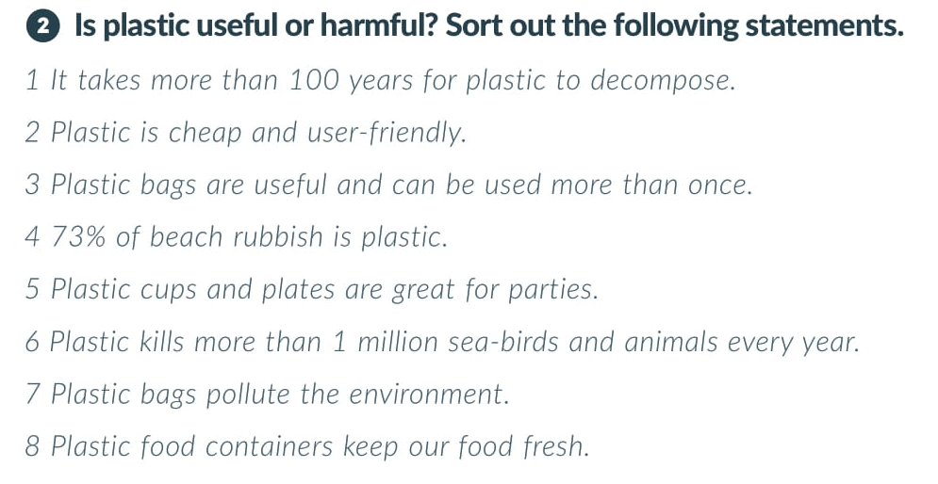
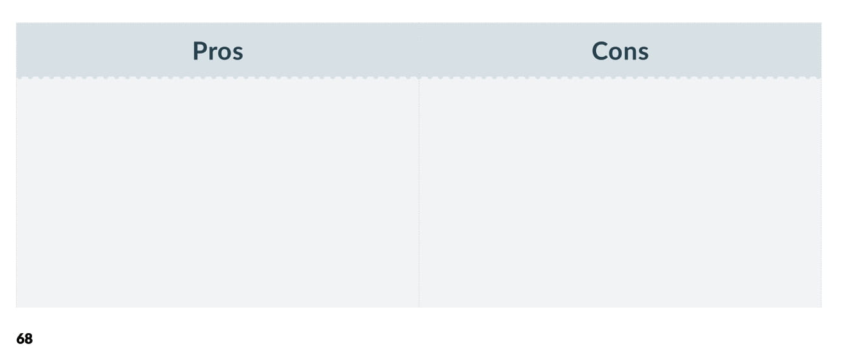
Plastic is cheap and user-friendly.
It takes more than 100 years for plastic to decompose.
Plastic bags are useful and can be used more than once.
73% of beach rubbish is plastic.
Plastic cups and plates are great for parties.
Plastic kills more than 1 million sea-birds and animals every year.
Plastic food containers keep our food fresh.
Plastic bags pollute the environment.

Slide 16
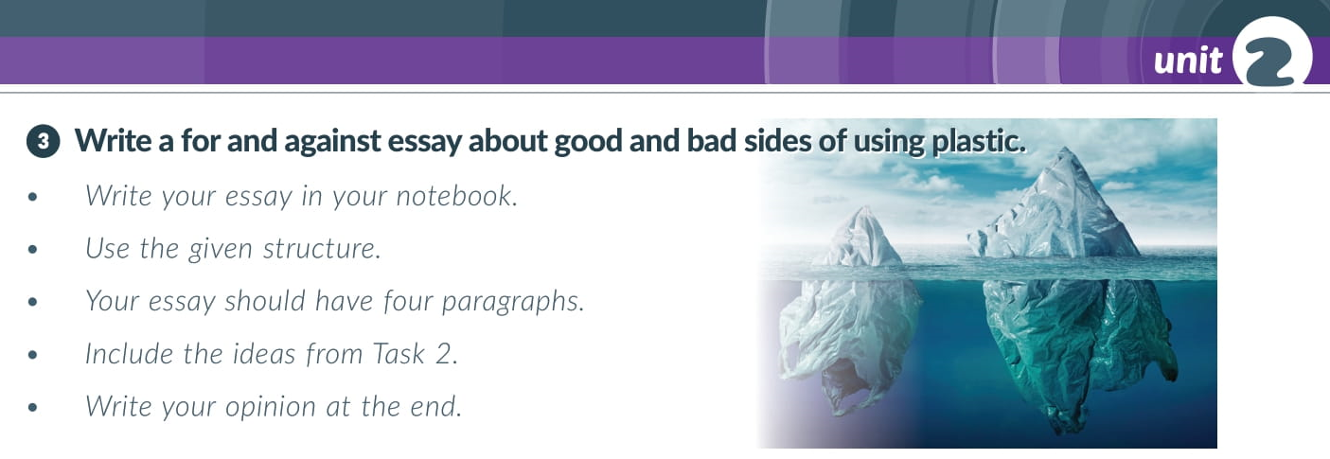

Slide 17


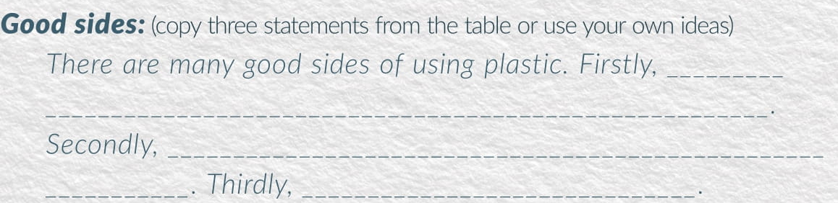

Slide 18
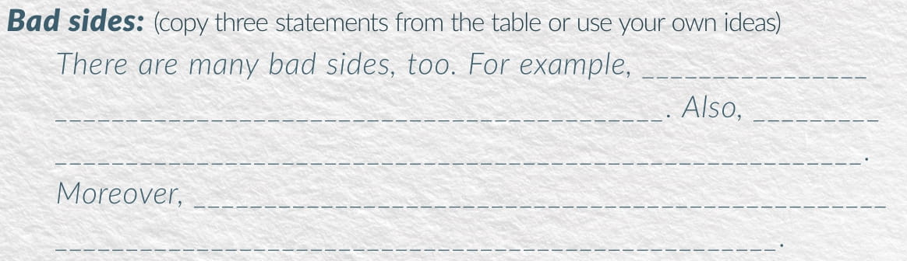
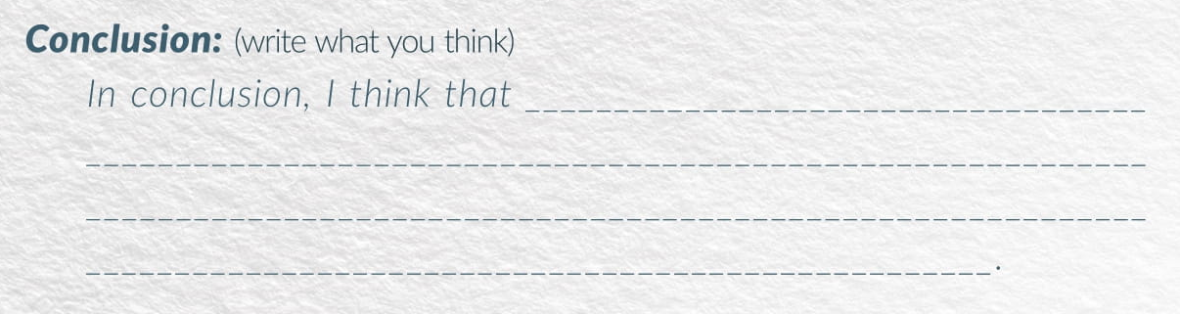

Slide 19
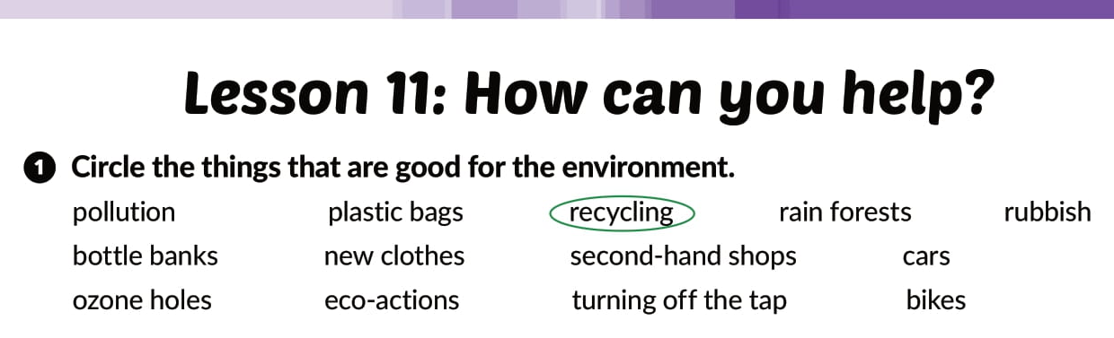
workbook p.50

Slide 20

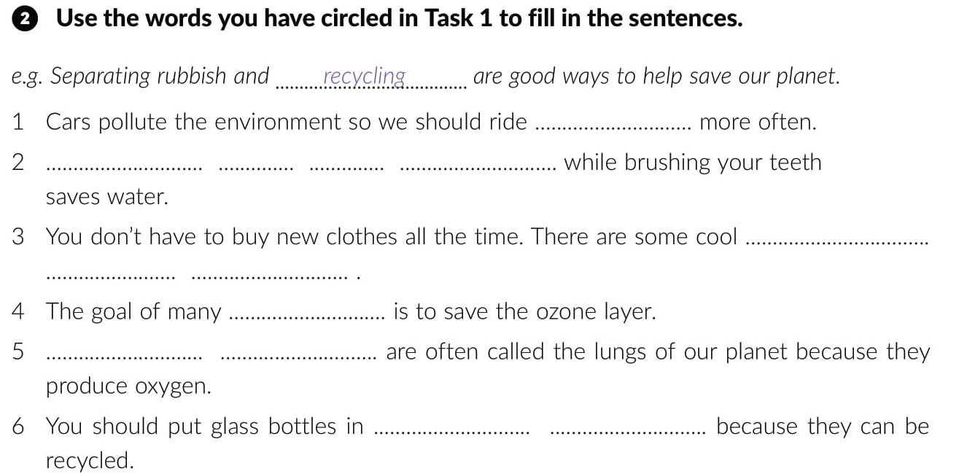
bikes
Turning
off
the
tap
second-
hand
shops
eco-actions
Rain
forests
bottle
banks

Slide 21
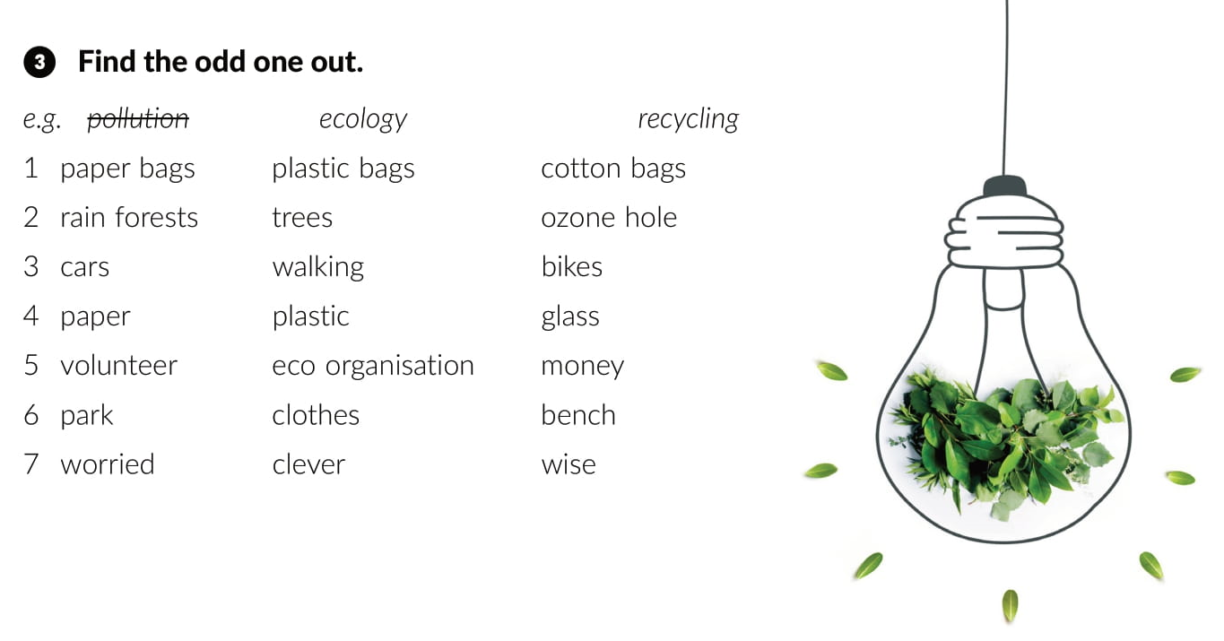

Slide 22
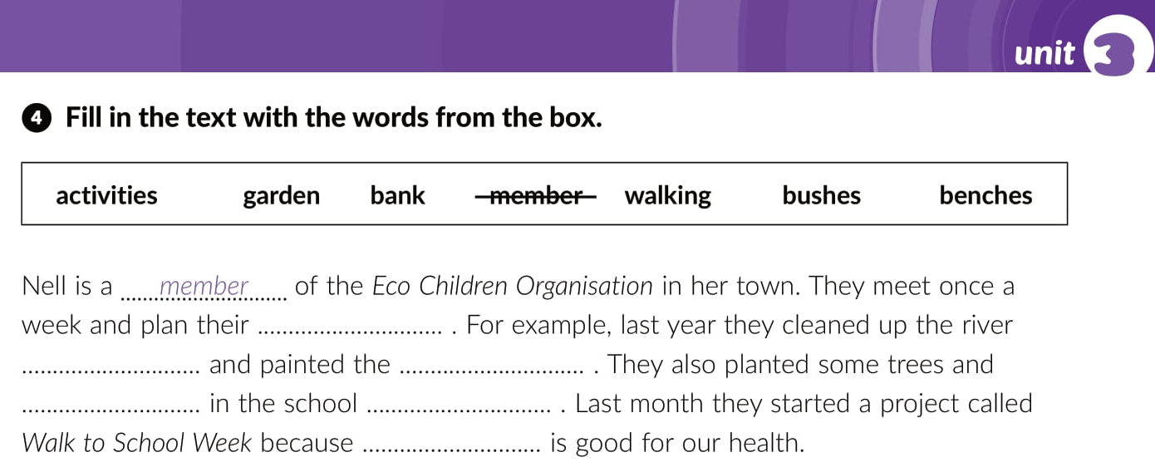
activities
bank
benches
bushes
garden
walking

Slide 23
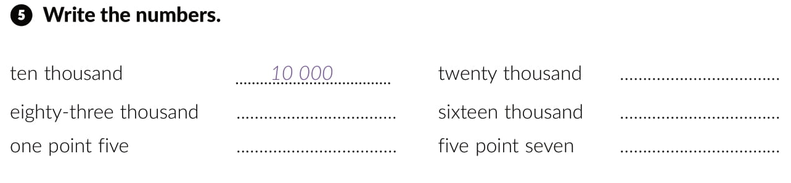
20 000
83 000
16 000
1.5
5.7

Slide 24
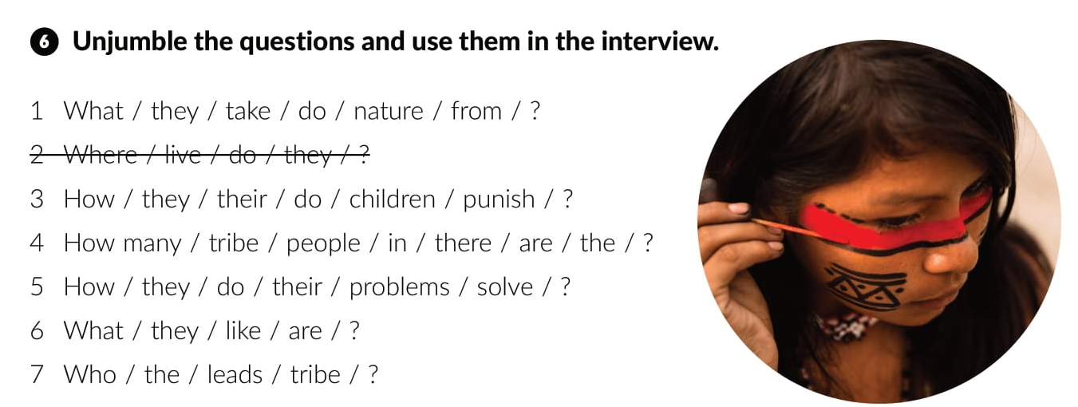
1. What do they take from nature?
3. How do they punish their children?
4. How many people are there in the tribe?
5. How do they solve their problems?
6. What are they like?
7. Who leads the tribe?

Slide 25
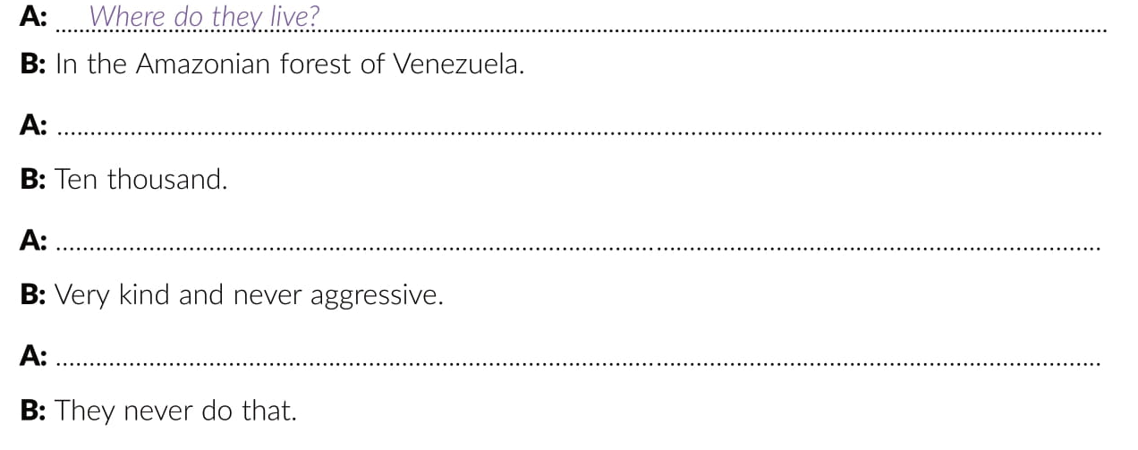
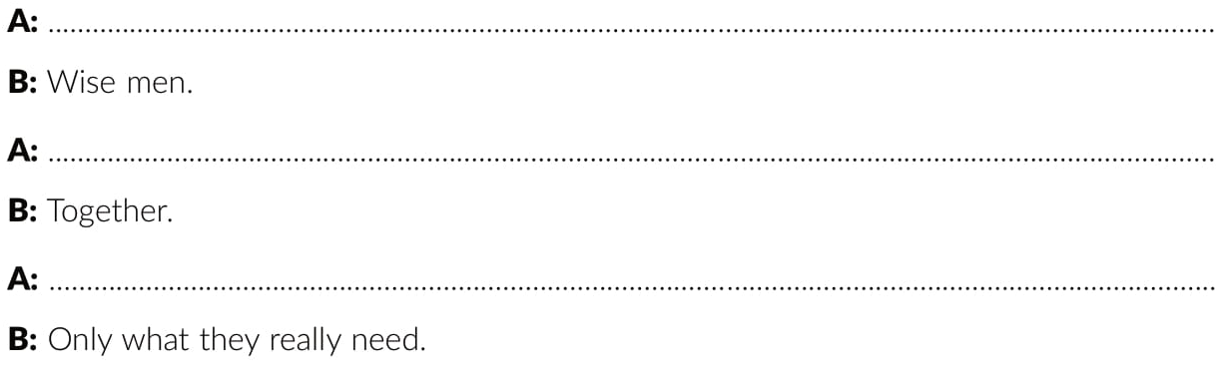
How many people are there in the tribe?
What are they like?
How do they punish their children?
Who leads the tribe?
How do they solve their problems?
What do they take from nature?

Slide 26
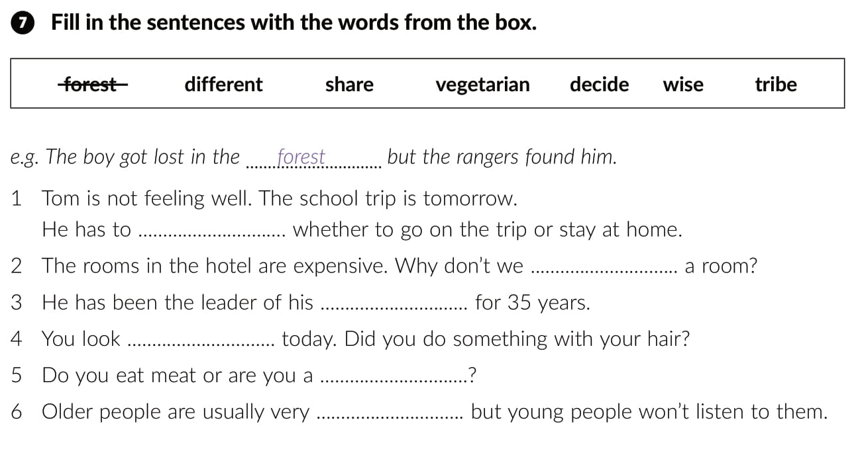
decide
share
tribe
different
vegetarian
wise

Slide 27
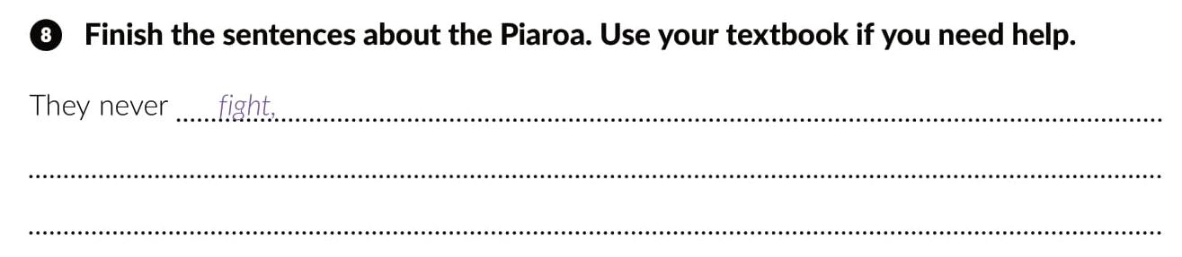
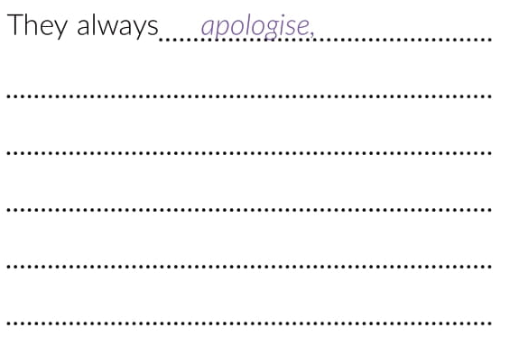
They never swear or shout.
They are never angry or nervous.
They never punish anyone.
They never eat meat.
They never have short meetings.
They share everything they have.
They love and respect nature.
They only eat vegetables.
They always discuss problems.
They take from nature only what they need.

Slide 28
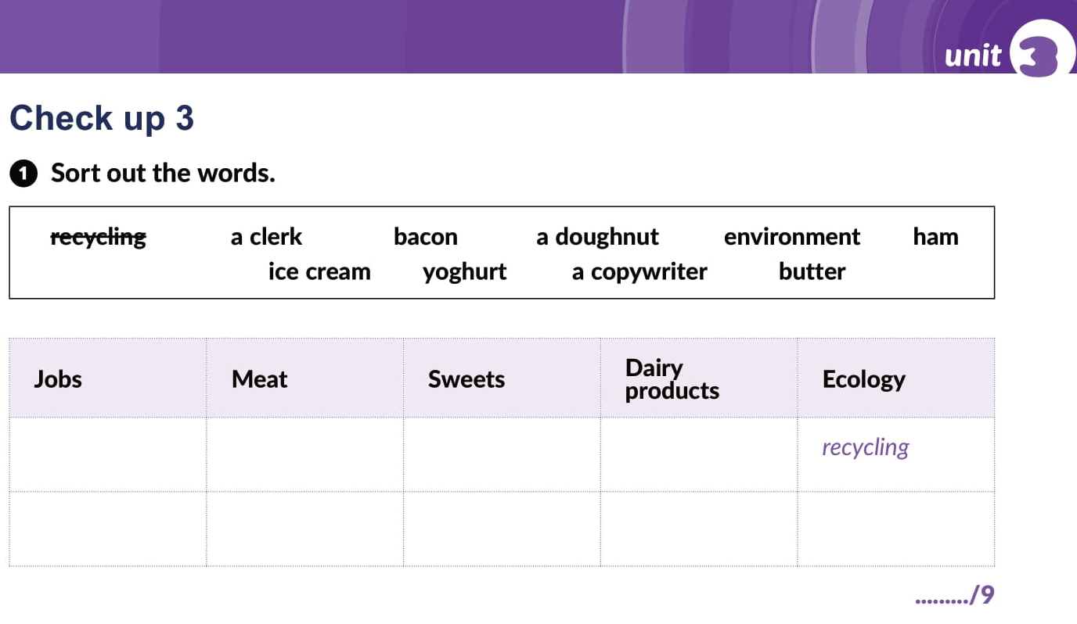
a clerk
bacon
a doughnut
yoghurt
a copywriter
ham
ice cream
butter
environment

Slide 29
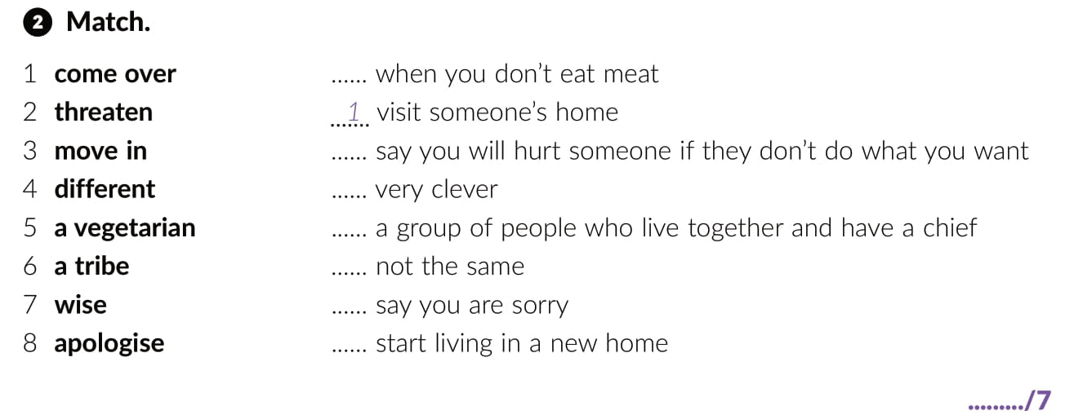
5
2
7
6
4
8
3

Slide 30
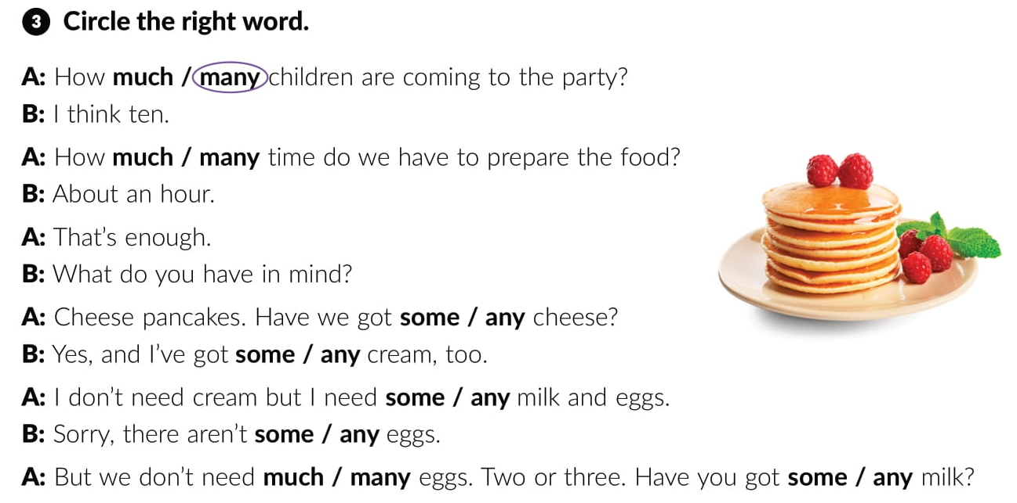
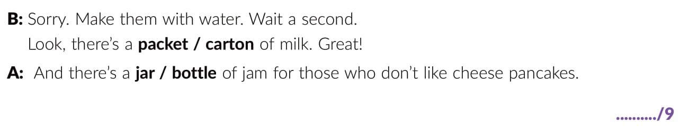

Slide 31
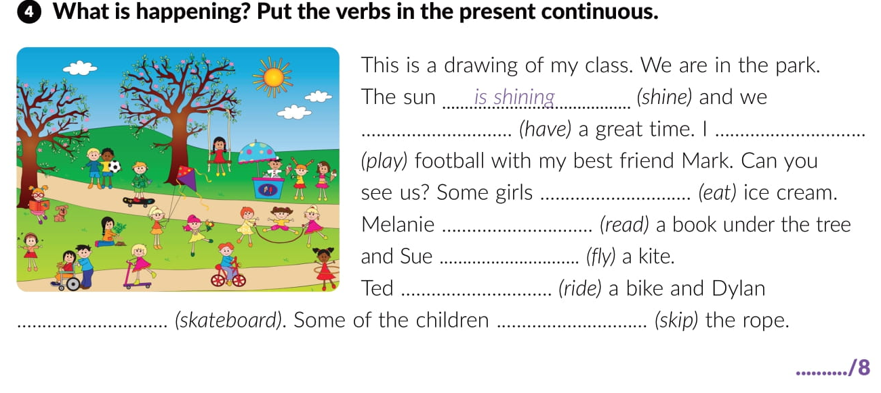
are having
am playing
are eating
is reading
is flying
is riding
is skateboarding
are skipping

Slide 32
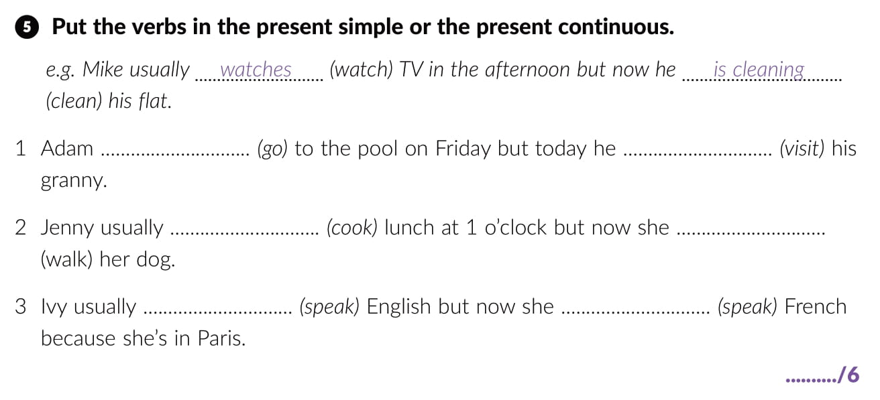
goes
is visiting
cooks
is walking
speaks
is speaking

Slide 33
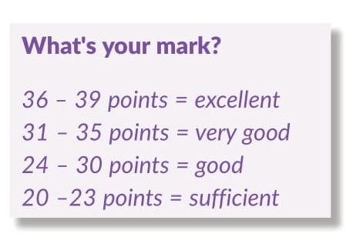


Slide 34
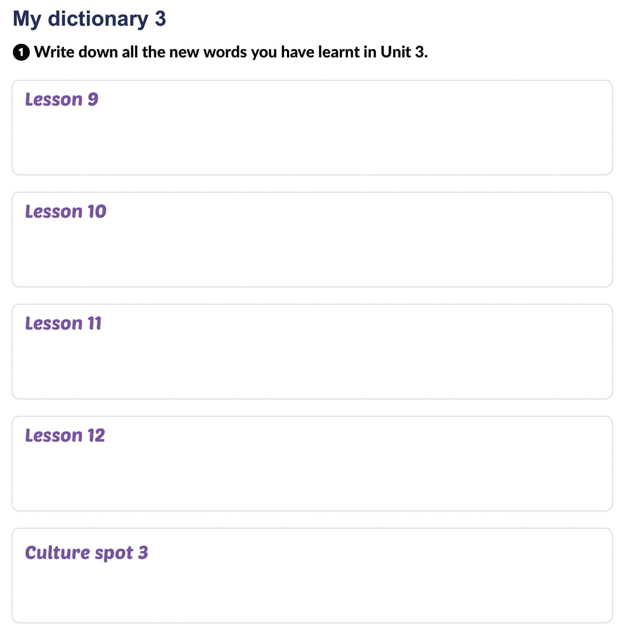

Slide 35
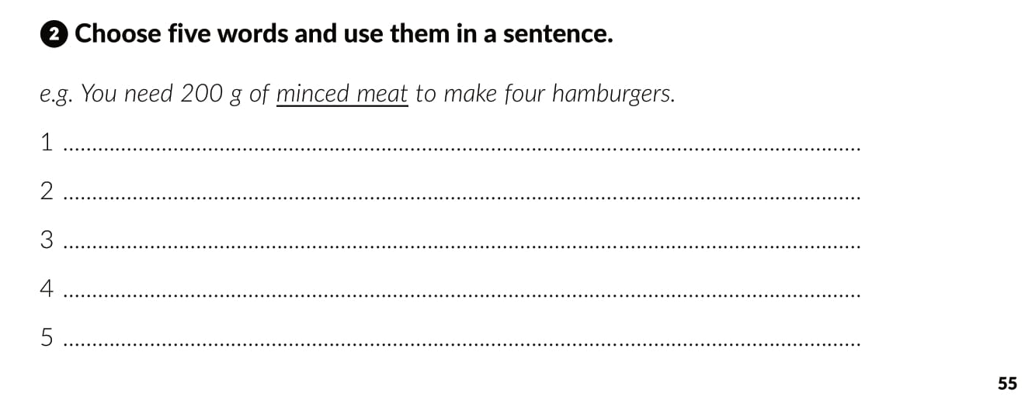

Slide 36

PLAY AND LEARN
Lesson 11 How can you help | Way to go 3 (e-sfera.hr)

